Slide 1
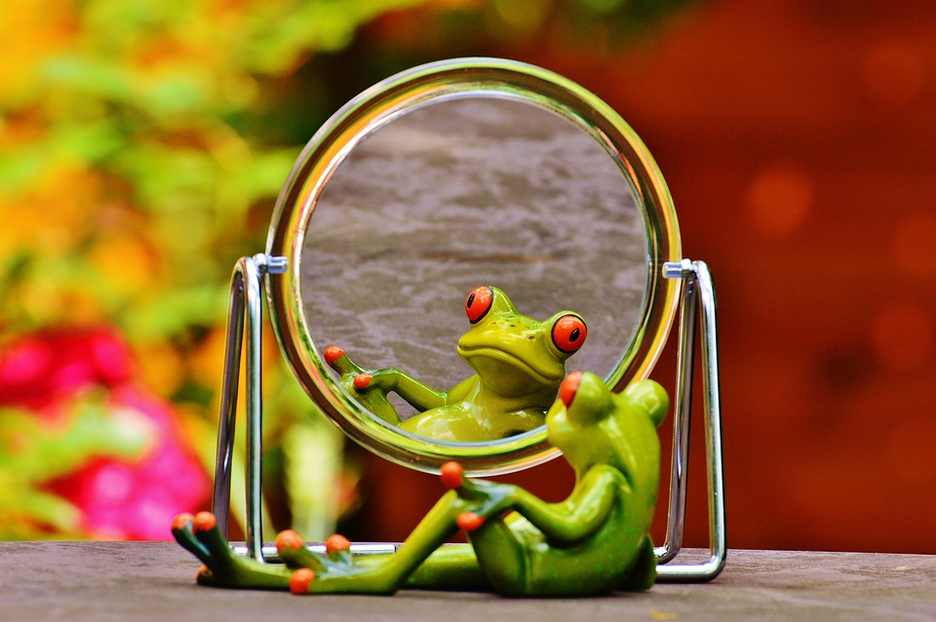
Welcome by The View session You are You
What did we talk about last time?

Slide 2
The destination session 3
Today i learn:
What i'm not
Who i am in the eyes of God.
That it is more important how God looks at me than how people do.

Slide 3
You are you!
but who are you?
Write down 5 words about who you think you are...

Slide 4
What are you not? You are not:
What you’re doing (e.g. hobby)
What you have (e.g. money)
What other people say (e.g. ‘you’re not good enough’)

Slide 5

You are a child of God!
a child of the highest King...

Slide 6
God says:
for the Lord seeth not as man seeth; for man looketh on the outward appearance, but the Lord looketh on the heart.
film

Slide 7


Slide 8
Creative assignment:
Write a letter to yourself
Answer the next questions:
What did you learn from The View?
What do you want to say to yourself?
What is your wish for yourself?

