Slide 1
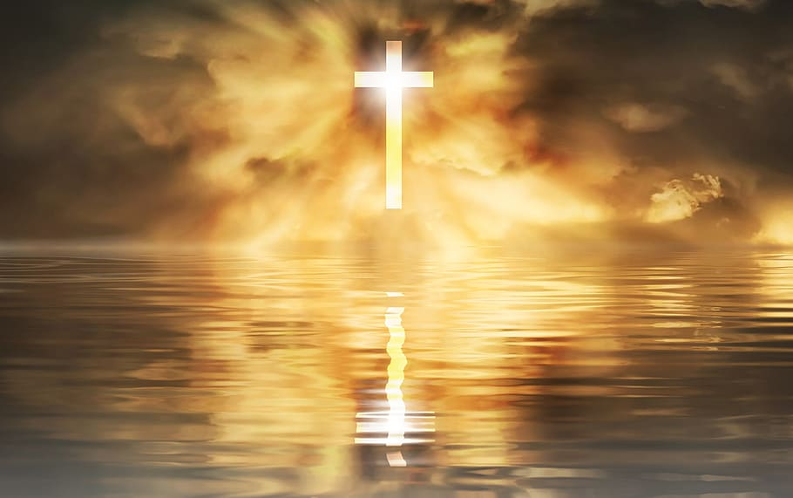
Welcome by The View session 2 Who is God.
What did we talk about last time?

Slide 2

The destination session 2
Today i learn:
Who the God of the bible is.
What that means for my life.
what I believe about God and how I see Him

Slide 3

God is God
Where do you think about when you think about God?

Slide 4
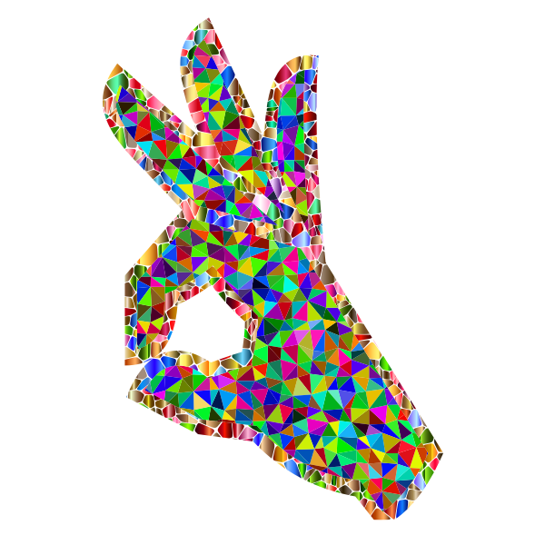
This it what the bible says:
Deuteronomy 32:4
4 He is the Rock, his work is perfect: For all his ways are judgment: a God of truth and without iniquity, just and right is he.
God is real

Slide 5
Revelation 1:8
I am Alpha and Omega, the beginning and the ending, saith the Lord, which is, and which was, and which is to come, the Almighty.
John 14:7
If ye had known me, ye should have known my Father also: and from henceforth ye know him, and have seen him.
If you know Jesus, you know God
John 8:44b - is about the devil
He was a murderer from the beginning, and abode not in the truth, because there is no truth in him. When he speaketh a lie, he speaketh of his own: for he is a liar, and the father of it.

Slide 6
Gods truth
GOD | The devil
Truth | Lie
Good | Evil
Peace | Fear
Love | Hate
Forgiveness | Revenge
Healing | Sickness
Life | Dead

Slide 7

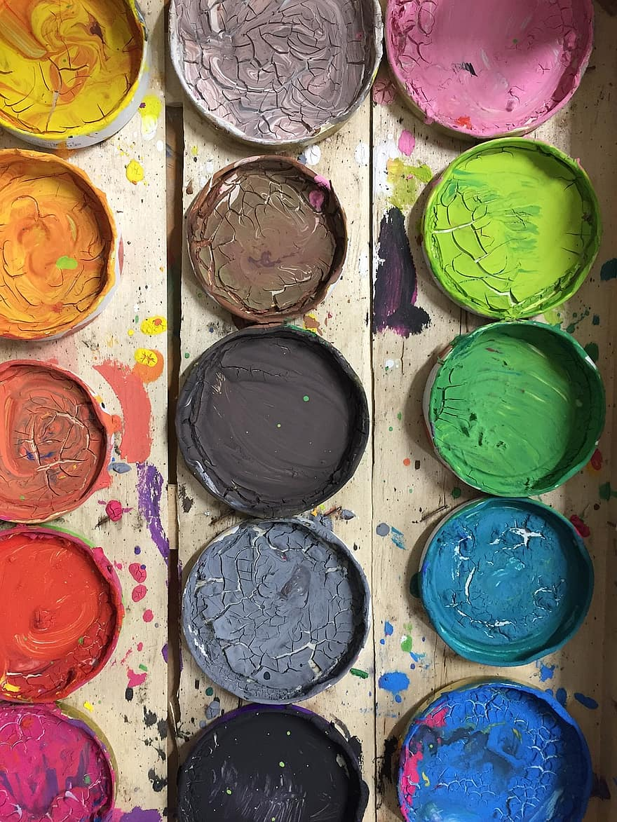
Creative Assignment:
Paint God!

