Slide 1

Welcome by The View
The View means: the view, the point of view, the judgment, the opinion, the eye.

Slide 2

The destination session 1
Today i learn:
what God's plan is for the world.
How i become aware of the lies and the truth.
what and Who our hope is.
That there is a choice.

Slide 3
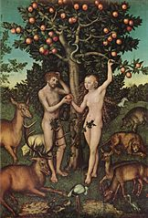
In the beginning
the beginning

Slide 4
The temptation
How lies enter our lives:
1. You hear a lie (e.g. you are not good enough)
2. You listen to it
3. You believe in it
4. You act on it

Slide 5
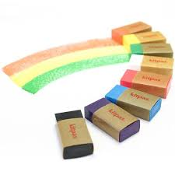
Creative assignment:
Lie vs Truth…

